Slide 1
Chapter 3. Basic elements
해석개발팀
선행파트
신헌섭

Slide 2
Ch. 3. Basic elements
1 Preliminaries
2 Interpolataion
and shap func
3 Formulas for
element matricies
4 Linear Triangle
5 Quadratic Triangle
6 Bilinear Rectangle
7 Quadratic
Rectangle
8 Rectangular Solid
element
9 Choice of
interpolation funcs
10 Improved Triangles
and Quardrilaterals
11 Nodal loads
12 Stress Calc
13 Nature of a FEM
가장 널리 쓰이는 요소의 기반은 displacement-based이므로 displacement-based 의 단순 요소 설명과 강성행렬을 구성하는 방법을 안다.
목적 :

Slide 3
Ch. 3. Basic elements
Stress-Strain Relations in general form
1 Preliminaries
2 Interpolataion
and shap func
3 Formulas for
element matricies
4 Linear Triangle
5 Quadratic Triangle
6 Bilinear Rectangle
7 Quadratic
Rectangle
8 Rectangular Solid
element
9 Choice of
interpolation funcs
10 Improved Triangles
and Quardrilaterals
11 Nodal loads
12 Stress Calc
13 Nature of a FEM
Stresses
matrix
Constitutive
matrix
Strains
matrix
Initial stresses
matrix
Strain-Disp Relations
Compatibility
바디가 파괴(breaking)없이 변형(deformation)될 때 크랙,비정상적 뒤틀림(kink), 파티클끼리의 관동이 없고 변위가 연속적이며 단일함수값(single-valued function of position)을 요구한다.

Slide 4
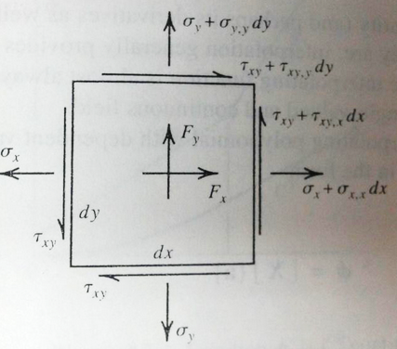

Ch. 3. Basic elements
1 Preliminaries
2 Interpolataion
and shap func
3 Formulas for
element matricies
4 Linear Triangle
5 Quadratic Triangle
6 Bilinear Rectangle
7 Quadratic
Rectangle
8 Rectangular Solid
element
9 Choice of
interpolation funcs
10 Improved Triangles
and Quardrilaterals
11 Nodal loads
12 Stress Calc
13 Nature of a FEM
Equilibrium equations : 미소면적에 대해..
Boundary Condition: surface traction 을 따라 다음과 같이 정의할 수 있다.
where
Exact solution VS Approximate solutions
적합조건,
평형조건,
경계조건
만족
모든 materal point에서
조건을 만족하진 않음
In intergral or average sense

Slide 5
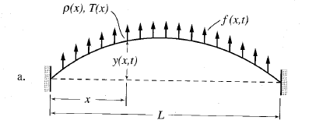
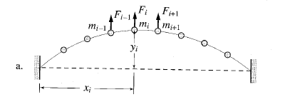

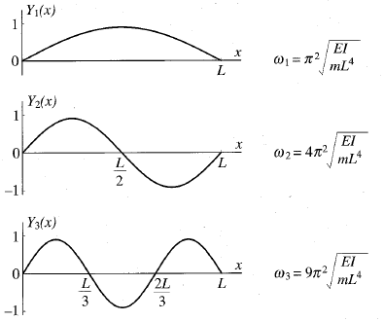
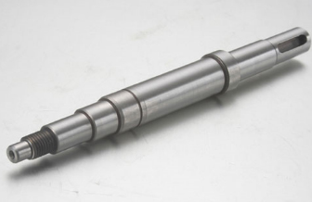
Shape function? => Stiffness matrix, Mass matrix, external Force matrix
Ch. 3. Basic elements
1 Preliminaries
2 Interpolataion
and shap func
3 Formulas for
element matricies
4 Linear Triangle
5 Quadratic Triangle
6 Bilinear Rectangle
7 Quadratic
Rectangle
8 Rectangular Solid
element
9 Choice of
interpolation funcs
10 Improved Triangles
and Quardrilaterals
11 Nodal loads
12 Stress Calc
13 Nature of a FEM
Exact solution VS Approximate solutions
Continuous system vs Lumped system
Expressed using
Polynominal function

Slide 6
Shape function?
Ch. 3. Basic elements
1 Preliminaries
2 Interpolataion
and shap func
3 Formulas for
element matricies
4 Linear Triangle
5 Quadratic Triangle
6 Bilinear Rectangle
7 Quadratic
Rectangle
8 Rectangular Solid
element
9 Choice of
interpolation funcs
10 Improved Triangles
and Quardrilaterals
11 Nodal loads
12 Stress Calc
13 Nature of a FEM
Exact solution VS Approximate solutions
Continues system vs Lumped system
VS

Slide 7
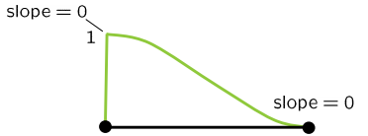
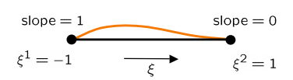
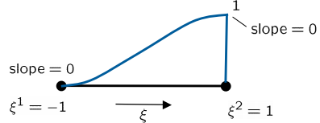
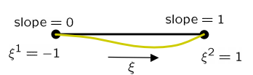
Ch. 3. Basic elements
Shape function in FEM
1 Preliminaries
2 Interpolataion
and shap func
3 Formulas for
element matricies
4 Linear Triangle
5 Quadratic Triangle
6 Bilinear Rectangle
7 Quadratic
Rectangle
8 Rectangular Solid
element
9 Choice of
interpolation funcs
10 Improved Triangles
and Quardrilaterals
11 Nodal loads
12 Stress Calc
13 Nature of a FEM

Slide 8
Ch. 3. Basic elements
Shape function in FEM
1 Preliminaries
2 Interpolataion
and shap func
3 Formulas for
element matricies
4 Linear Triangle
5 Quadratic Triangle
6 Bilinear Rectangle
7 Quadratic
Rectangle
8 Rectangular Solid
element
9 Choice of
interpolation funcs
10 Improved Triangles
and Quardrilaterals
11 Nodal loads
12 Stress Calc
13 Nature of a FEM
위치에 따른deformation
inverse
Node의
dis, slope
Shape matrix
Node의 dis와 slope을 알면 shape matrix를 통해 보의 위치 x에 따른 빔의 변형을 알 수 있다.
11

Slide 9

Shape function?
Ch. 3. Basic elements
1 Preliminaries
2 Interpolataion
and shap func
3 Formulas for
element matricies
4 Linear Triangle
5 Quadratic Triangle
6 Bilinear Rectangle
7 Quadratic
Rectangle
8 Rectangular Solid
element
9 Choice of
interpolation funcs
10 Improved Triangles
and Quardrilaterals
11 Nodal loads
12 Stress Calc
13 Nature of a FEM
FVS Approximate solutions
Continues system vs Lumped system
여러 개의 node를 이용하여 표현가능!
Number of modes
infinite
Number of element $×$ 2

Slide 10
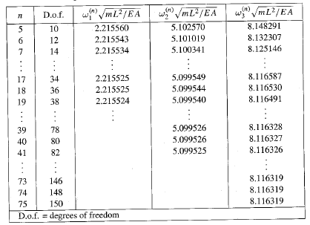
Shape function?
Ch. 3. Basic elements
1 Preliminaries
2 Interpolataion
and shap func
3 Formulas for
element matricies
4 Linear Triangle
5 Quadratic Triangle
6 Bilinear Rectangle
7 Quadratic
Rectangle
8 Rectangular Solid
element
9 Choice of
interpolation funcs
10 Improved Triangles
and Quardrilaterals
11 Nodal loads
12 Stress Calc
13 Nature of a FEM
Exact solution VS Approximate solutions
Continues system vs Lumped system
Exact solution
Exact solution
Exact solution
여러 개의 node를 이용하여 표현가능!
Number of modes
infinite
Number of element $×$ 2

Slide 11
Stiffness matrix, Mass matrix, external Force matrix
Ch. 3. Basic elements
Shape function =>
1 Preliminaries
2 Interpolataion
and shap func
3 Formulas for
element matricies
4 Linear Triangle
5 Quadratic Triangle
6 Bilinear Rectangle
7 Quadratic
Rectangle
8 Rectangular Solid
element
9 Choice of
interpolation funcs
10 Improved Triangles
and Quardrilaterals
11 Nodal loads
12 Stress Calc
13 Nature of a FEM
Virtual work principle
Virtual work by internal force
Virtual work by external force
Displacement - Nodal displacement relation
Strain – displacement relation
Strain – nodal displacement relation

Slide 12
Stiffness matrix, Mass matrix, external Force matrix
Ch. 3. Basic elements
Shape function =>
1 Preliminaries
2 Interpolataion
and shap func
3 Formulas for
element matricies
4 Linear Triangle
5 Quadratic Triangle
6 Bilinear Rectangle
7 Quadratic
Rectangle
8 Rectangular Solid
element
9 Choice of
interpolation funcs
10 Improved Triangles
and Quardrilaterals
11 Nodal loads
12 Stress Calc
13 Nature of a FEM
Virtual work principle
Virtual work by internal force
Virtual work by external force
Displacement - Nodal displacement relation
Strain – displacement relation
Strain – nodal displacement relation
Stiffness matrix

Slide 13
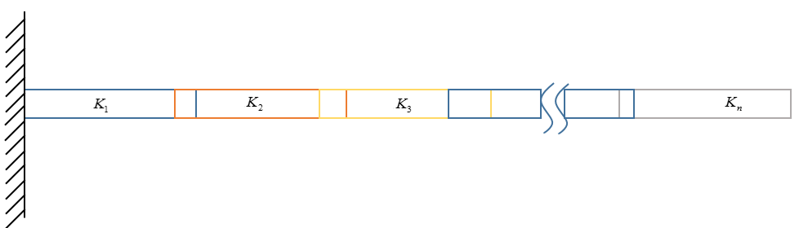
Ch. 3. Basic elements
1 Preliminaries
2 Interpolataion
and shap func
3 Formulas for
element matricies
4 Linear Triangle
5 Quadratic Triangle
6 Bilinear Rectangle
7 Quadratic
Rectangle
8 Rectangular Solid
element
9 Choice of
interpolation funcs
10 Improved Triangles
and Quardrilaterals
11 Nodal loads
12 Stress Calc
13 Nature of a FEM
Continuous system Shape function
Orthogonality
Continuous system Shape function
Global
Stiffness matrix
Non-Orthogonality

Slide 14
Ch. 3. Basic elements
1 Preliminaries
2 Interpolataion
and shap func
3 Formulas for
element matricies
4 Linear Triangle
5 Quadratic Triangle
6 Bilinear Rectangle
7 Quadratic
Rectangle
8 Rectangular Solid
element
9 Choice of
interpolation funcs
10 Improved Triangles
and Quardrilaterals
11 Nodal loads
12 Stress Calc
13 Nature of a FEM

Slide 15
Ch. 3. Basic elements
1 Preliminaries
2 Interpolataion
and shap func
3 Formulas for
element matricies
4 Linear Triangle
5 Quadratic Triangle
6 Bilinear Rectangle
7 Quadratic
Rectangle
8 Rectangular Solid
element
9 Choice of
interpolation funcs
10 Improved Triangles
and Quardrilaterals
11 Nodal loads
12 Stress Calc
13 Nature of a FEM
Boundary condition
Eigen analysis<=M, F

Slide 16
Ch. 3. Basic elements
Linear Triangle(scalar field element)
bar
1 Preliminaries
2 Interpolataion
and shap func
3 Formulas for
element matricies
4 Linear Triangle
5 Quadratic Triangle
6 Bilinear Rectangle
7 Quadratic
Rectangle
8 Rectangular Solid
element
9 Choice of
interpolation funcs
10 Improved Triangles
and Quardrilaterals
11 Nodal loads
12 Stress Calc
13 Nature of a FEM
Using Cartesian coordinate
beam
Linear Triangle(CST element)

Slide 17
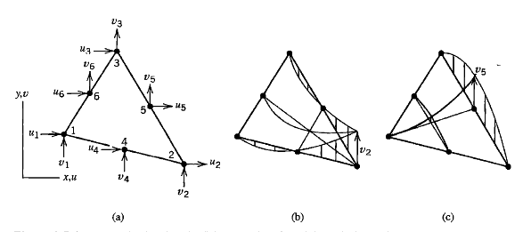
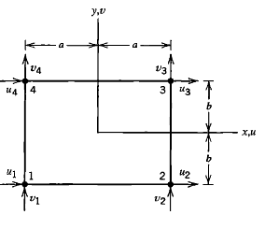
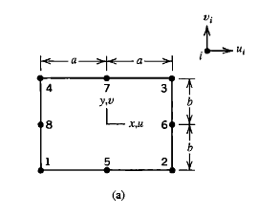
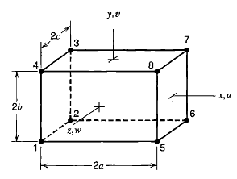
Ch. 3. Basic elements
1 Preliminaries
2 Interpolataion
and shap func
3 Formulas for
element matricies
4 Linear Triangle
5 Quadratic Triangle
6 Bilinear Rectangle
7 Quadratic
Rectangle
8 Rectangular Solid
element
9 Choice of
interpolation funcs
10 Improved
Triangles
and
Quardrilaterals
11 Nodal loads
12 Stress Calc
13 Nature of a FEM
Quadratic Triangle(LST)
Bilinear Rectangle(Q4)
Quadratic rectangle (Q8, Q9)
Rectangular solid elements

Slide 18
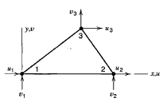
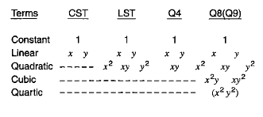

Ch. 3. Basic elements
정확한 값으로 수렴되기 위한 mesh의 적절한 element을 선정
강체운동 및 구속상태를 표현
1 Preliminaries
2 Interpolataion
and shap func
3 Formulas for
element matricies
4 Linear Triangle
5 Quadratic Triangle
6 Bilinear Rectangle
7 Quadratic
Rectangle
8 Rectangular Solid
element
9 Choice of
interpolation funcs
10 Improved
Triangles
and
Quardrilaterals
11 Nodal loads
12 Stress Calc
13 Nature of a FEM
Rigid body
Linear field
Constant
Strain
states
Polynomal
displacement field
Balance

Slide 19
Ch. 3. Basic elements
Concentrated force
1 Preliminaries
2 Interpolataion
and shap func
3 Formulas for
element matricies
4 Linear Triangle
5 Quadratic Triangle
6 Bilinear Rectangle
7 Quadratic
Rectangle
8 Rectangular Solid
element
9 Choice of
interpolation funcs
10 Improved
Triangles
and
Quardrilaterals
11 Nodal loads
12 Stress Calc
13 Nature of a FEM
Distributed force
Work-Equivalent Loads
Work
Nodal
disp
Nodal
loads
Concentrated force
Distributed force
along with boundary shape

Slide 20
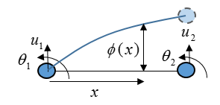
Ch. 3. Basic elements
Stress calculation
1 Preliminaries
2 Interpolataion
and shap func
3 Formulas for
element matricies
4 Linear Triangle
5 Quadratic Triangle
6 Bilinear Rectangle
7 Quadratic
Rectangle
8 Rectangular Solid
element
9 Choice of
interpolation funcs
10 Improved
Triangles
and
Quardrilaterals
11 Nodal loads
12 Stress Calc
13 Nature of a FEM
where
미분
Strain field 는 Displacement field 미분형태=> 더 큰 오차
계산된 응력은 보통 요소의 경계보다 내부에서 정확한 값을 가진다
절점에서 평균화된 응력 값을 사용할 경우, 더 신뢰도 있는 값을 얻을 수 있다. 하지만 불연속성이 클 경우, mesh size가 크다라는 경고일 수도 있다.
Nature of finite element solution
Compatibility prevails at nodes: 연결된 각각의 절점에서 요소들은 동일한 변위 성분을 지닌다.
Exact sol
Equilibrium of nodal force and moments is satisfied
Equilibrium is usually not satisfied within elements

